Slide 1



IBM
Cloud Computing
Project Name : Personal Blog on IBM cloud Static Web Apps
Theme: Personal Food Blog

Slide 2
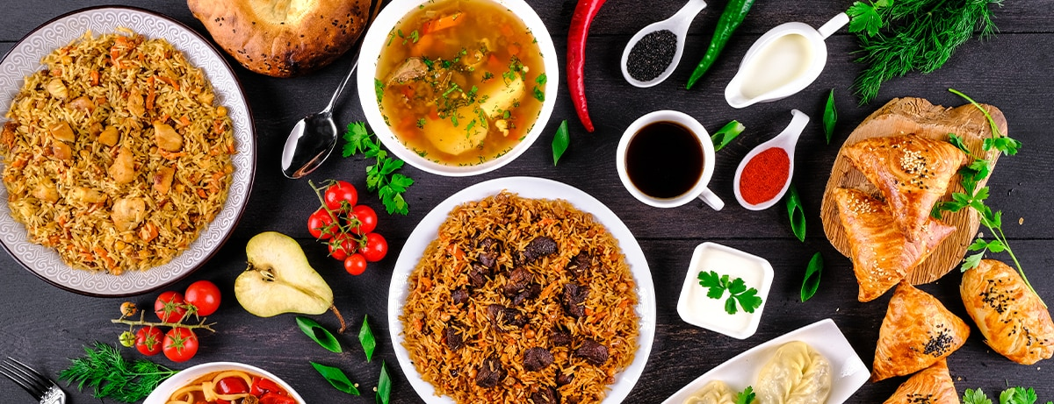
FOOD BLOG
THE GOOD FOODS STARTS WITH GOOD PRODUCT

Slide 3


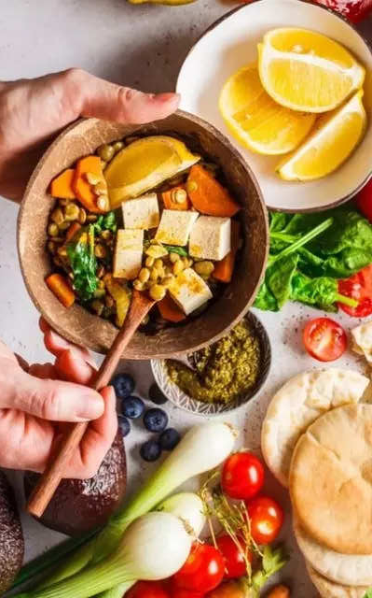
Project definition:
Design Thinking:
Content Planning:
Plan the blogs Structure , including sections for foods stories ,Eco -friendly tips , photos and possibly a map showing the restaurants places
Content Creation:
Writing about the latest food trends, like plant-based eating or air fryer recipes.
Website Design:
Design an aesthetically pleasing and user-friendly layout for the blog using HTML,CSS and Possibly JavaScript for interactive elements.
IBM Cloud Setup:
Set up an account on IBM Cloud and create a Static Web App to host the blog.
Content Management:
Choose a suitable Content Management System(CMS) or Static site generator to make it easy to update and manage it.
The project is to create a personal food blog hosted on IBM Cloud Static Web Apps
The goal is to share food journalism interlinking a gourmet interest in food ,tips ,food photography .
Our Food Blog can be about the cuisine of different cultures and offer readers a way to access delicious receipes and kitchen tips without having to shell out for a cookbook or make a call to a relative for help.

Slide 4
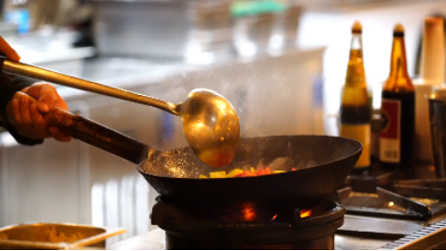
Cooking Tips Demo:
Click playbutton to watch below video:
Tips

Slide 5
Thank you

